Slide 1

Design and analysis of experiments
George Savva (January 2024)

Slide 2
Purpose
Principles of experimental design and analysis
Signposting to help and resources
Based on experience at NBI since 2017
Motivation – meta-science
How to be a better scientist
Purpose of experiments
Design guidelines
Analysis guidelines
Dilemmas
Lectures plus group discussion
Ask questions throughout!
1-30 to 3 – Experimental design
3-30 to 5 – Analysis plus ‘dilemmas’
Hopefully something for everyone

Slide 3
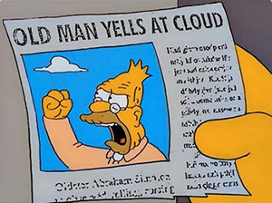
Nothing (much) in here is new
“…. these lessons appear to be either unread, ignored, not believed, or forgotten as each new wave of researchers is introduced to the brave new technical lexicon of medical research….”
Goodman (2008) A Dirty Dozen: Twelve P-Value Misconceptions, Seminars in Hematology 45 (3) https://www.sciencedirect.com/science/article/abs/pii/S0037196308000620

Slide 4
About me
What do I do?
Design
Analysis
Reporting
Review
Mentoring
Integrity
Teaching and training
Helping students!
PhD John Innes Centre (Bioinformatics) 2001-2004
Medical statistician / epidemiologist (2004-2017)
QIB Statistician since 2017

Slide 5
About you
What is your job?
As a scientist?
As a PhD student?
Discover things
Test things
Report fairly
Do all of this responsibly
Support your institution
Role model being a good scientist
Complete your project
Learn to do science well
Keep up with the field (methodological, substantive, policy etc)
Educate your seniors

Slide 6
Take home message - Read!
Do bioinformaticians need ‘basic’ statistics??
Bioinformatics / data science is a different skill set to statistics
Methods are highly computational, can deal with complex models of data from different sources
Much of bioinformatics is repeated application of basic statistics (often forgotten in the complexity)
The basic experimental design principles (where does your data come from, how to make valid and precise comparisons) are exactly the same
No amount of fancy analysis or bioinformatics can rescue poor experimental design
Methods textbooks
Including experimental design and
Statistical analysis
Zeitgeist
General journals / Science social media / Blogs / Science news / policy
Eg replication crisis, meta-science, new computational tools etc
For your substantive work - conduct systematic literature review if you can
Reproducible
Unbiased
Comprehensive

Slide 7
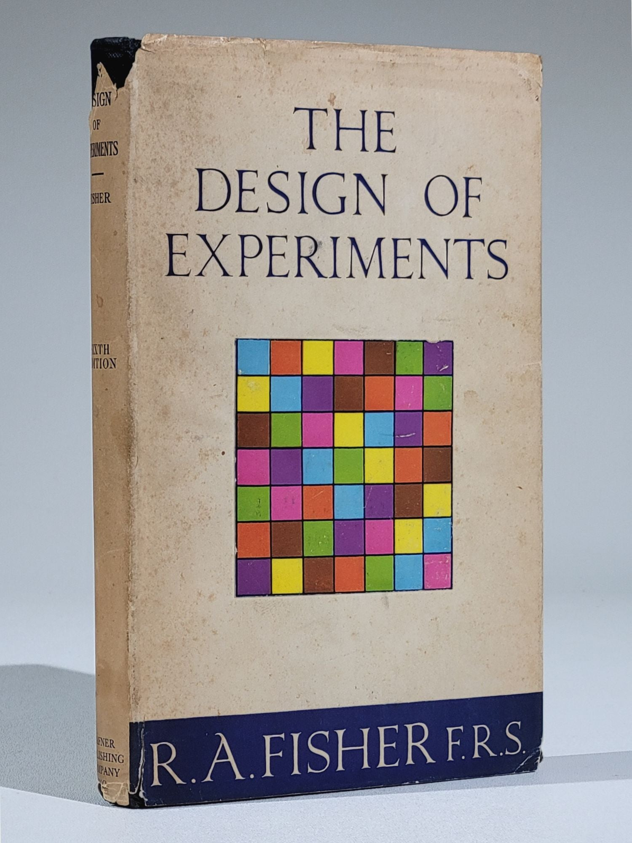
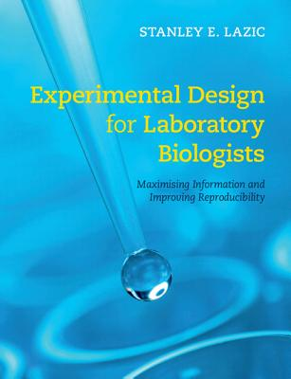

Experimental design texts
1949 (5th ed). But still very relevant and interesting to read.
A word on Fisher and Galton..
Very practical and accessible, particularly useful for animal studies but also for bench scientists
The basics of doing research with actual people in a clinical context

Slide 8
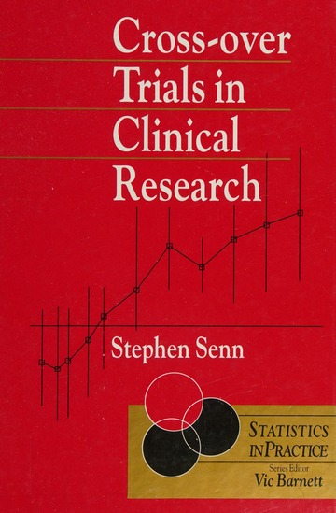


Specific methods texts
Texts for specific designs, and those I’ve had recommended by PIs for different disciplines.

Slide 9
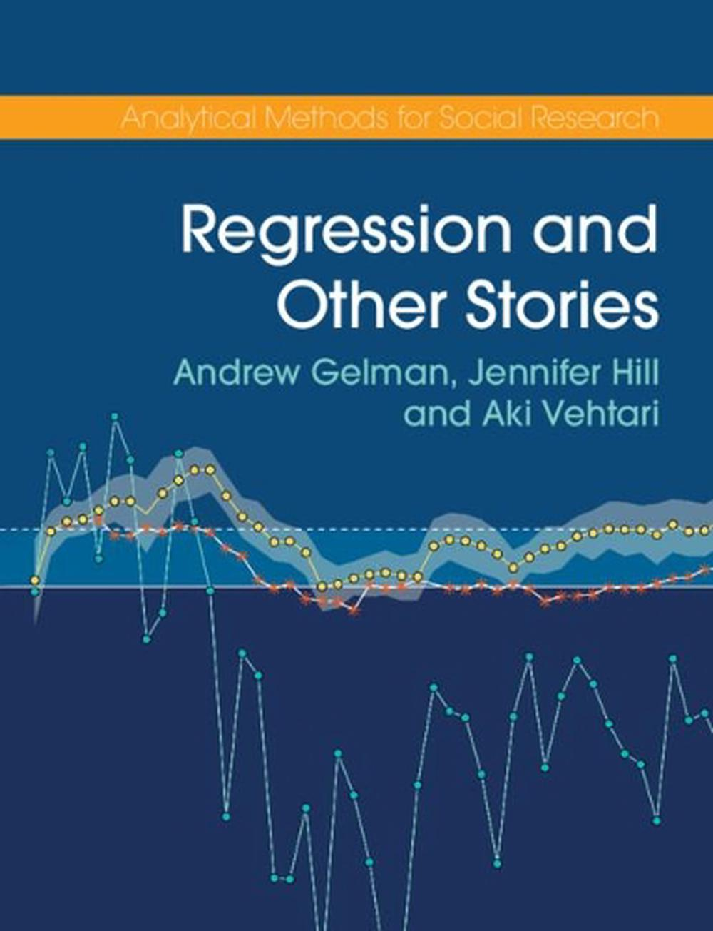
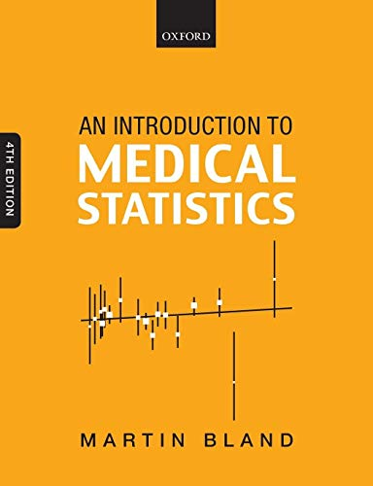

Analysis texts

Slide 10
Other sources of help
Training courses
Do the NBI statistics courses (basic, experimental design, mixed models)
Find external courses
Technical support
Statistics
Bioinformatics
Imaging, etc
Wider community – online, local
Eg - Biostars, Cross-validated, NC3RS
Use the training courses and the help you have!
Is prior work or lab folklore helpful?
“A post-doc in my lab told me…”
Or
“everyone in my field does this”
Can be, but can also be dangerous

Slide 11
‘Systematic’ literature review
It is important that your work makes a genuine contribution
So... What is already known on this topic?
Reproducible search.
Document:
Search keywords
Search engines, dates, etc
Number of hits
Number of relevant articles
Which articles not included and why
Systematic extraction of information
This way you know you have got everything, you know you aren’t cherry picking, and the review is trustworthy to others.
You know what important open questions are currently being asked
So called ‘narrative’ reviews are near worthless scientifically.
Explore this if you haven’t already
Replication is valuable, answering questions that we already know the answers to is not
Several occasions where I’ve been asked to design a study where there was an enormous amount of published literature that PIs were not aware of

Slide 12
How good are we at science?
It’s worth understanding the state of the art.
Is our current practice OK?
Are our findings true?
Do our methods work?
How would we know if the results we produce are ‘correct’?

Slide 13

Direct evidence: Replication project cancer biology
Aim: Test the results of preclinical studies in cancer research.
Key results taken from high quality journals
Experiments repeated as closely as possible with proper designs
Sample sizes calculated to achieve 80% power
158 published effects re-examined.
Questions for you
If all of the published results were correct, how many results should have been replicated?
What does it mean for a study to fail to replicate?
Guess what proportion of 158 results in basic oncology were successfully replicated?
If you took a random high-profile published result in your area and replicated it, what do you think the chance is that you’d get the same result?
https://www.cos.io/rpcb

Slide 14
Results
Same direction and significant…
Perfect – 80%
Completely by chance – 2.5%
How many of the studies replicated?
Of ‘significant positive findings’ (97 tested)
42 / 97 = 43% positive effects were reproduced
Effect sizes were ~75% lower in the replications
Questions for you:
What does this mean?
What is going on?
Why do you think basic science studies fail to replicate?
Is it a problem for the field?
What is the harm?
https://www.cos.io/rpcb

Slide 15

Causes of replication failure
Underpowered studies
False negatives
Temptation to ‘fudge’ results
Biased analysis, poor design, analysis :
False positives
Questions can’t be answered
Questionable research practices
False positives, suppression of negative findings
Much of our work has suffered from this.
Things are improving….slowly
https://acmedsci.ac.uk/policy/policy-projects/reproducibility-and-reliability-of-biomedical-research

Slide 16
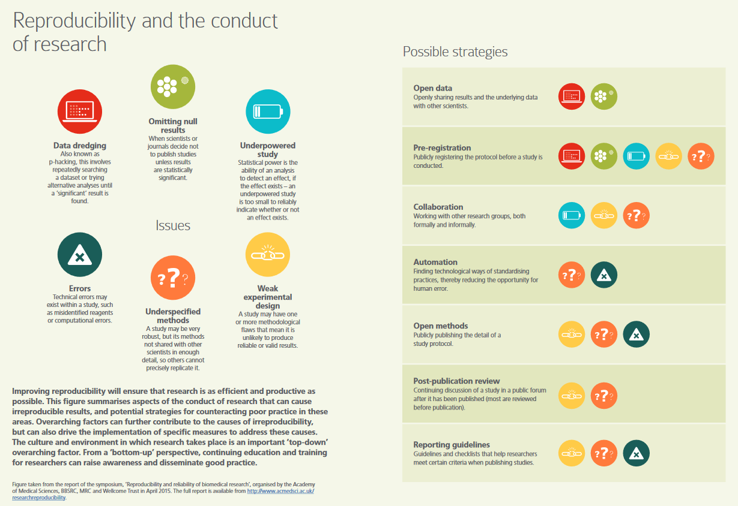
https://acmedsci.ac.uk/policy/policy-projects/reproducibility-and-reliability-of-biomedical-research

Slide 17
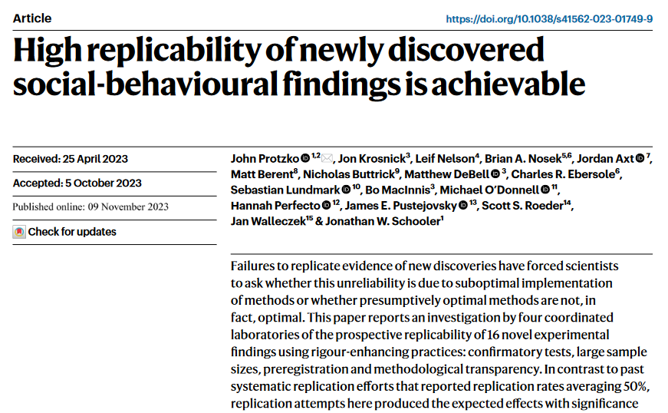
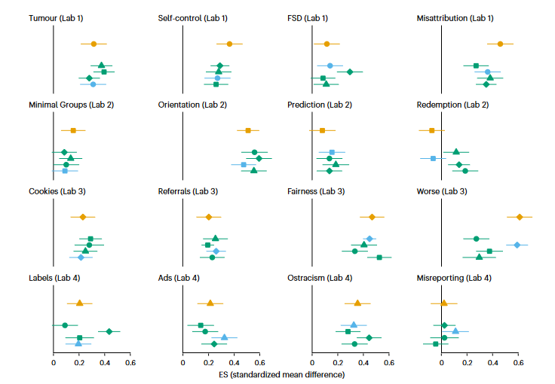
In social sciences..
Prospective Replication Study
Labs implemented ‘robustness’ measures in their research before starting.
86% reproducibility rate!!
Effect sizes 97% of the original
So it is possible to do reproducible science. Even in social science!
Protzko et al (2023) https://rdcu.be/dqL7b

Slide 18
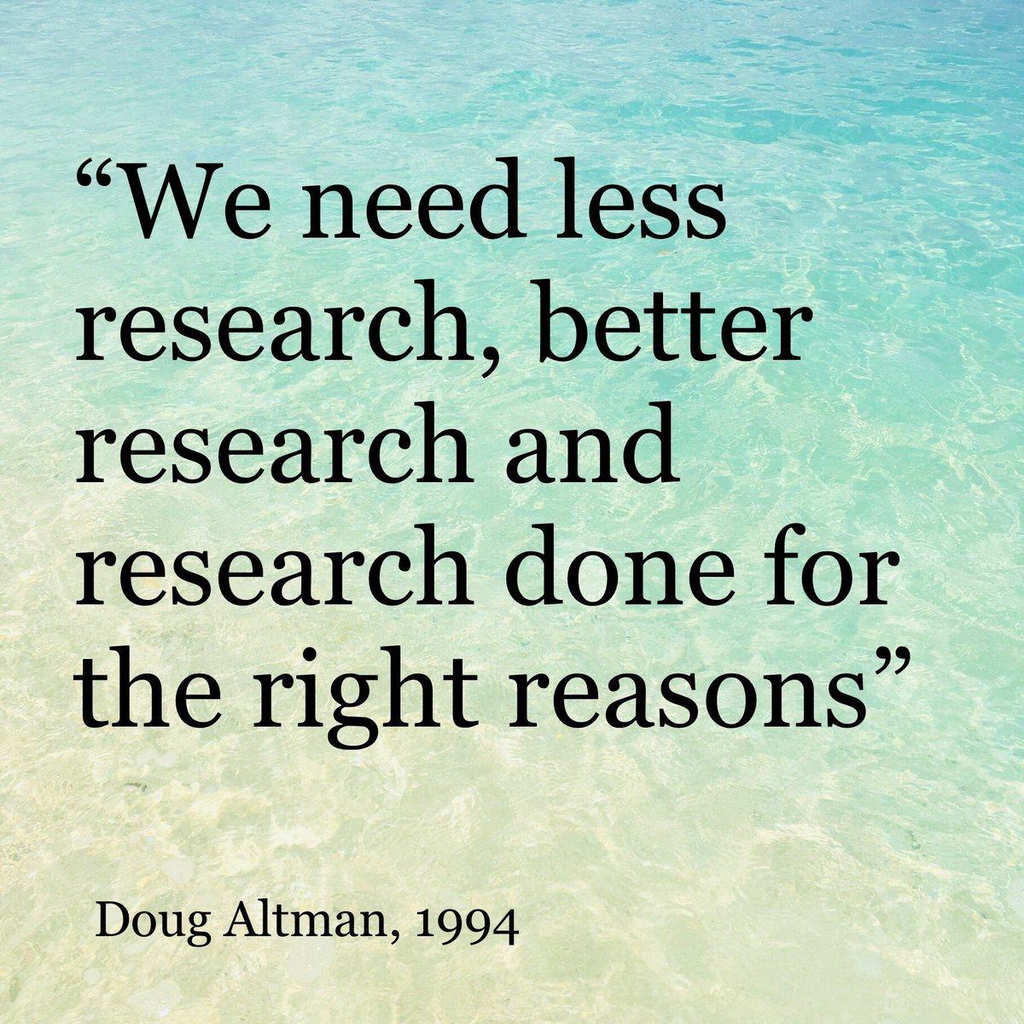
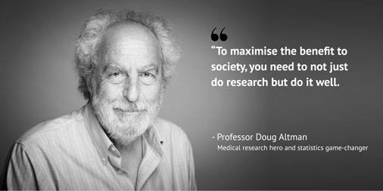
Can we do better?
Medical research, led by clinical trials of pharmaceuticals, had a renaissance in the late 1990s.
This is beginning to happen now in other fields including ours
Better study design
Better study analysis
Better reporting
Doug Altman (1948-2018)

Slide 19
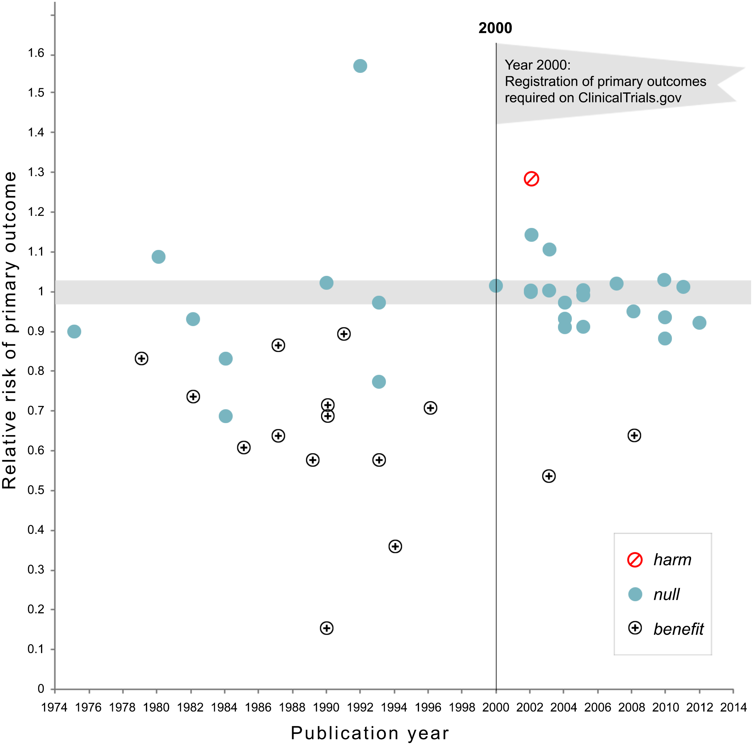
The effect on results of improving practice in human clinical trials (CTIMP) research
Around 20 years ago standards for human study conduct and reporting got much stricter.
Before pre-registration,
17 of 30 trials ‘succeeded’
After pre-registration,
2 of 25 trials ‘succeeded’
What does this tell us?
When scientists are forced to pre-register or report properly, their studies are much less often ‘significant’???
All large clinical trials funded by the National Heart Lung, and Blood Institute
Positive results probably QRPs not real results?
Are animal studies, lab scientists,
bioinformatics, epidemiology still in the dark ages?
https://journals.plos.org/plosone/article?id=10.1371/journal.pone.0132382 Kaplan and Irvin (2015)

Slide 20
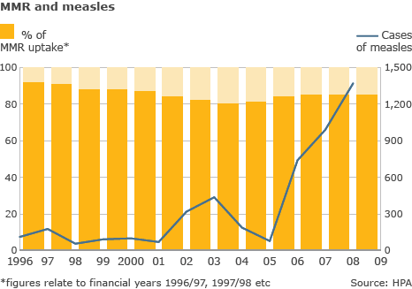
What are the implications bad science? Does science ‘self-correct?’
Wasted effort / opportunity cost
Retractions and reputational damage
Harm to patients / public / environment
Harm to our individuals in community
Loss of public trust
Loss of investment
Widely accepted now that there’s a problem
Self-correction? Nope (maybe eventually?)
In fact, bad science propagates (Smaldino and McElreath 2016)
Vaccine hesitancy leads to more disease
Others basing work on flawed theory – does it self-correct?
A waste of 1000 research papers –
how an entire field was wrong for decades
https://www.theatlantic.com/science/archive/2019/05/waste-1000-studies/589684/
https://royalsocietypublishing.org/doi/10.1098/rsos.160384

Slide 21
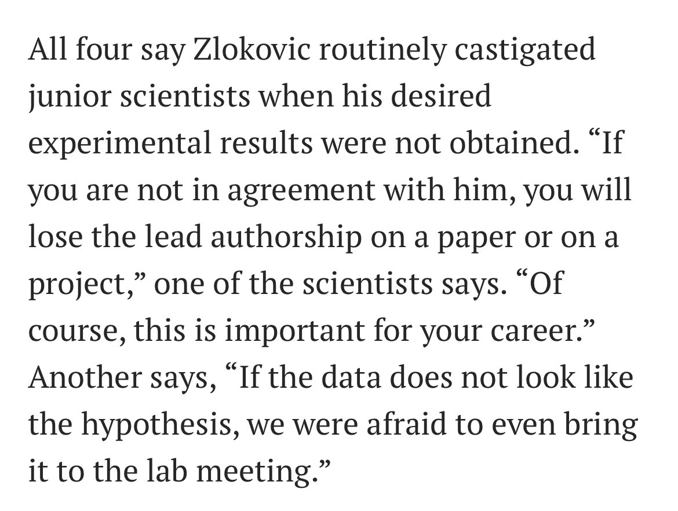
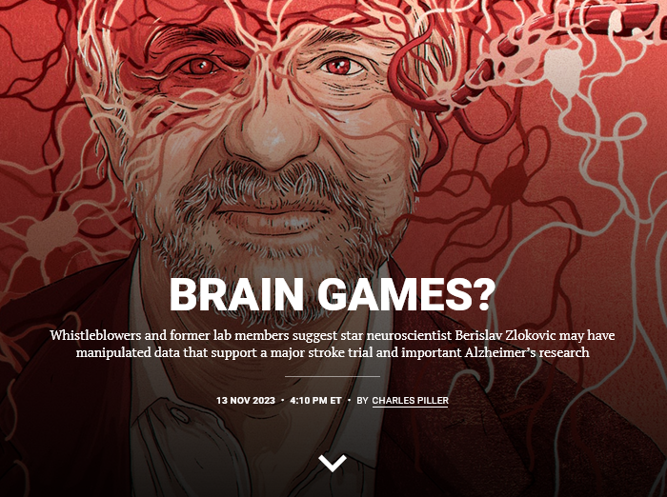
Does this happen here?
https://www.science.org/content/article/misconduct-concerns-possible-drug-risks-should-stop-stroke-trial-whistleblowers-say
Be aware of institutes whistleblowing and integrity policies and processes

Slide 22
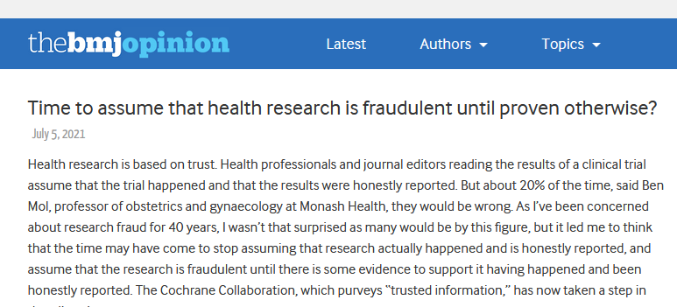
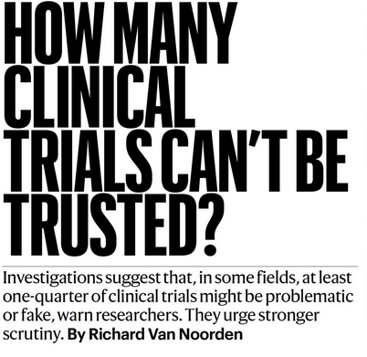
How much research is simply “made up”?
https://blogs.bmj.com/bmj/2021/07/05/time-to-assume-that-health-research-is-fraudulent-until-proved-otherwise/
https://www.nature.com/articles/d41586-023-02299-w

Slide 23

A completely fake publishing house?
Summary
Don’t believe everything you read
Science has an issue with ‘reproducibility’ (which is a euphemism for quality)
No reason to think NRP is better or worse than anywhere else
Many reasons for this
Studying design and analysis and implementing good practice will help us to improve
https://www.primescholars.com/articles/navigating-the-maze-of-drugs-a-multifaceted-perspective-123938.html

Slide 24
Design of Experiments

Slide 25
Our simple motivating example
A simple experiment:
We want to test the effect of a new medium (A) compared to our old medium (B) on plant growth.
We should grow some plants in medium A, some plants in medium B measure the heights, and see which are bigger.
Why do we need to think about ‘experimental design’?

Slide 26
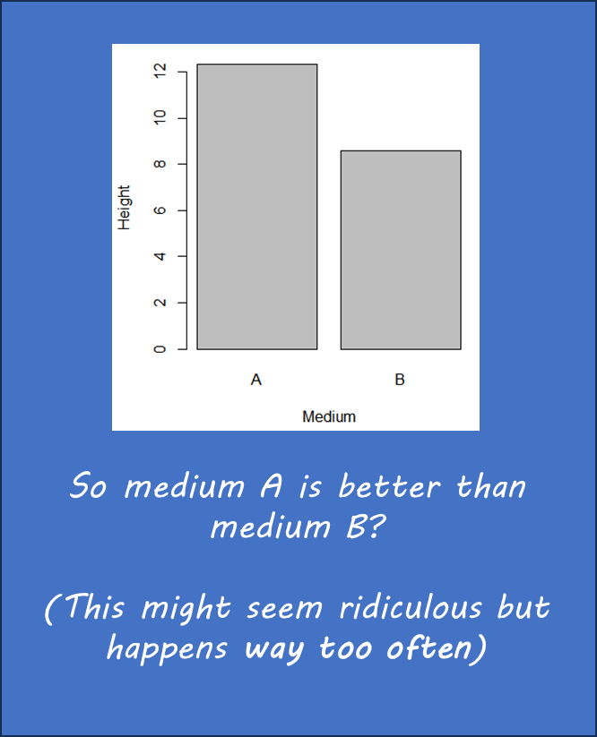
What might go wrong?
Argument:
“If the medium A plants are talller on average than medium B plants then medium A is better and we should recommend it, otherwise it isn’t.”
What could be the problem here?
What is our goal as scientists, what do we want to avoid?
Plant growth results
Medium A
10 cm
12 cm
15 cm
Medium B
9 cm
10 cm
11 cm
10 cm
3 cm
Anyone could design this..

Slide 27
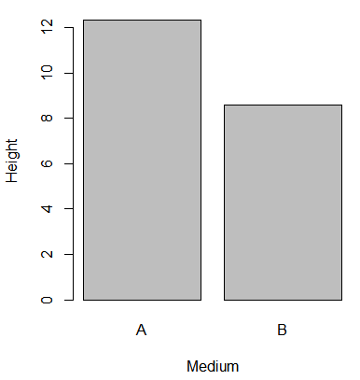
Possible design and analysis issues
(Things we might have come up with)
Measurement
Allocation (Randomisation)
Fidelity
Bias
Missing data
Replication
Sample size
Precision
Power
Generalisability
Usefulness
Effect size
Interpretation and Reporting
So medium A is better than medium B?
(This might seem ridiculous but happens way too often)

Slide 28
What is our goal
We want findings that are
Valid (true)
Unbiased
Precise
Useful
Generalisable
Replicable
Novel
Robust
Ethical
We want to avoid
False positives
False negatives
Harmful findings
Bias (size of effect errors)
Imprecision / inefficiency
Sloppy mistakes
Learning things that:
We already know
Nobody cares about

Slide 29
Fundamental experimental design/analysis equation:
Outcome = Treatment effect + Biological effect + Technical effect + Random Error
What we care about
Observable factors related to the experimental units
Factors related to our experimental design
Measurement error
Variation between units
Unmeasurable factors
Treatment error
What we can measure (readout)
Plant height
Yield
Health
(Select appropriately)
Effect of A vs B
Estimate?
Test?
Interactions with other factors?
Individual
Species
Genotype
(Sex)
Growth conditions
Treatment variation
Batch of medium
Contamination
Time of year
Assessor
Measurement error
Between-plant variance
From Lazic (2016)

Slide 30
So how should we design our experiment?
What should we have done to compare these growth media?
Is this possible to answer?
How do we make decisions about material, layout, measurement etc...

Slide 31
Elements of experimental design
What do we ultimately want to know?
Eg: Is medium A better than growth medium B?
Analysis
How will you use data answer the question set out in the objectives?
What comparisons will you make?
What quantities will you estimate
Mean difference in plant yield?
Design
Interventions
Replication
Sampling
Allocation
Sample size
Material
Sampling frame
Patient group
Controls
Exclusion criteria
Research question(s) (Question you will actually answer)
Are plants grown in medium A bigger than those grown in medium B in our greenhouse conditions
Measurement
What to measure?
When to measure?
How to measure?
Choose these elements to get the best estimate of mean difference that we can.

Slide 32
Setting the question

Slide 33
Setting the question
Every experiment needs a clear question to be designed well
It needs to be a question that has an answer, and it will be clear when the question has been answered
Real NBI example:
“We want to investigate the bacteria found on different retail meat products, how many samples should we take?”
First, this is not a question
Second, you can’t say when the aims have been met
So how can you design this? Needs to be much more specific, even though its an exploratory study
Our simple study aims to test a causal effect.
Growth medium -> Plant height
Not every experiment is to test a causal effect.
What other kinds of questions are there? (apart from causal)
Descriptive
Measurement/validation
Predictive
Others?

Slide 34
Causal vs Predictive
Are these two different questions?
Can I use the gut microbiome to diagnose Rheumatoid Arthritis?
Does the gut microbiome contribute to the incidence of RA?
Do these need different studies?
Is there a different ultimate purpose?
Does showing an association between microbiome and RA answer either question?

Slide 35
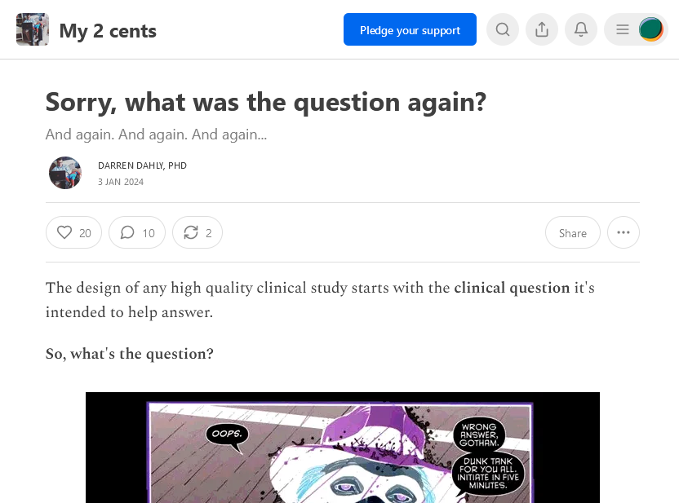
Plant growth study
What was the question exactly?
Is medium A better than medium B
For which plants?
In which conditions?
Explanatory (can it in the lab ?) / Pragmatic (does it in practice?)
By what measure?
Superior / non-inferior / by how much?
Over what time period?
Exactly what treatment? – Dose
Compared to what?
https://statsepi.substack.com/p/sorry-what-was-the-question-again
Darren Dahly is an applied statistician with an entertaining and insightful blog

Slide 36
Estimation vs Testing for causal questions
What is the most useful question to answer?
Does medium A cause bigger plants compared to medium B?
What is the average difference in height between plants grown in medium A compared to medium B?
Hypothesis Testing
Estimation
Useful to whom?
https://www.nature.com/articles/d41586-019-00857-9 Amrhein et al (2019)

Slide 37
How might we answer the question
Putting aside the question of design for the moment…
How might we answer the question of whether A is the better medium.
Or by how much?
Plant growth results
Medium A
10 cm
12 cm
15 cm
Medium B
9 cm
10 cm
11 cm
10 cm
3 cm

Slide 38
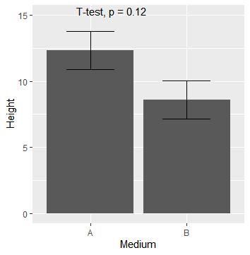
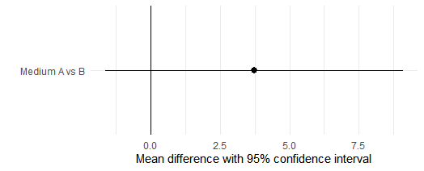
Estimation vs Testing (for causal questions)
Estimated mean difference: 3.7cm , 95% CI = (-1.4cm to 8.9cm), p=0.12
Dynamite plot with test
Can you interpret each analysis?

Slide 39
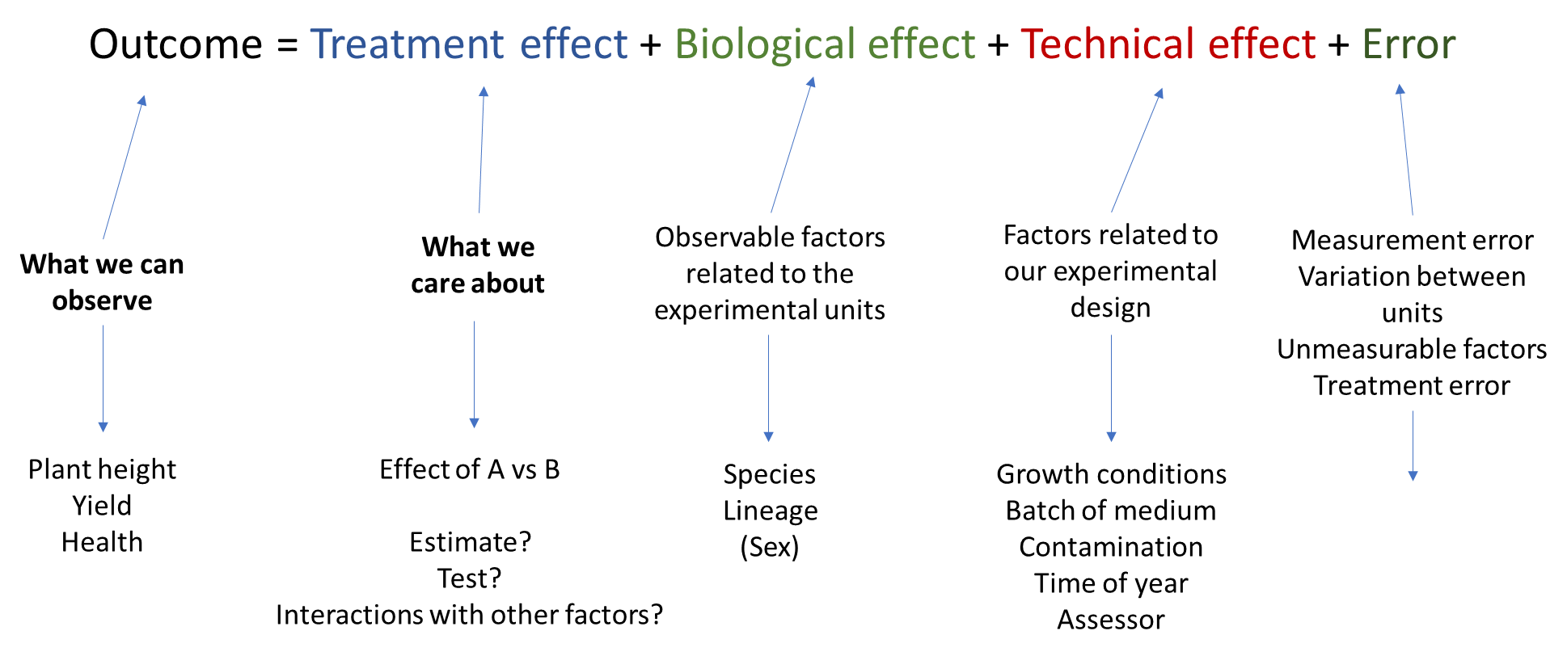
Treatment effect
So this ‘treatment effect’ is our target (estimand).
This gives us a framework for design and analysis.
We want the treatment effect estimate to be unbiased and precise.
The analysis aims to make statements about the treatment effect.
Aim of experimental design:
Account for biological effects, technical effects, and error.

Slide 40
Bias and precision
‘Truth‘ – fixed but unknown
Study estimates (observed, random)
Good study design (estimates will be close to truth)
-10
0.0
10
Imprecise
(High variance)
-10
0.0
10
Biased
(Systematic error)
-10
0.0
10
Mean difference

Slide 41
Bias and variance from nuisance factors

Slide 42
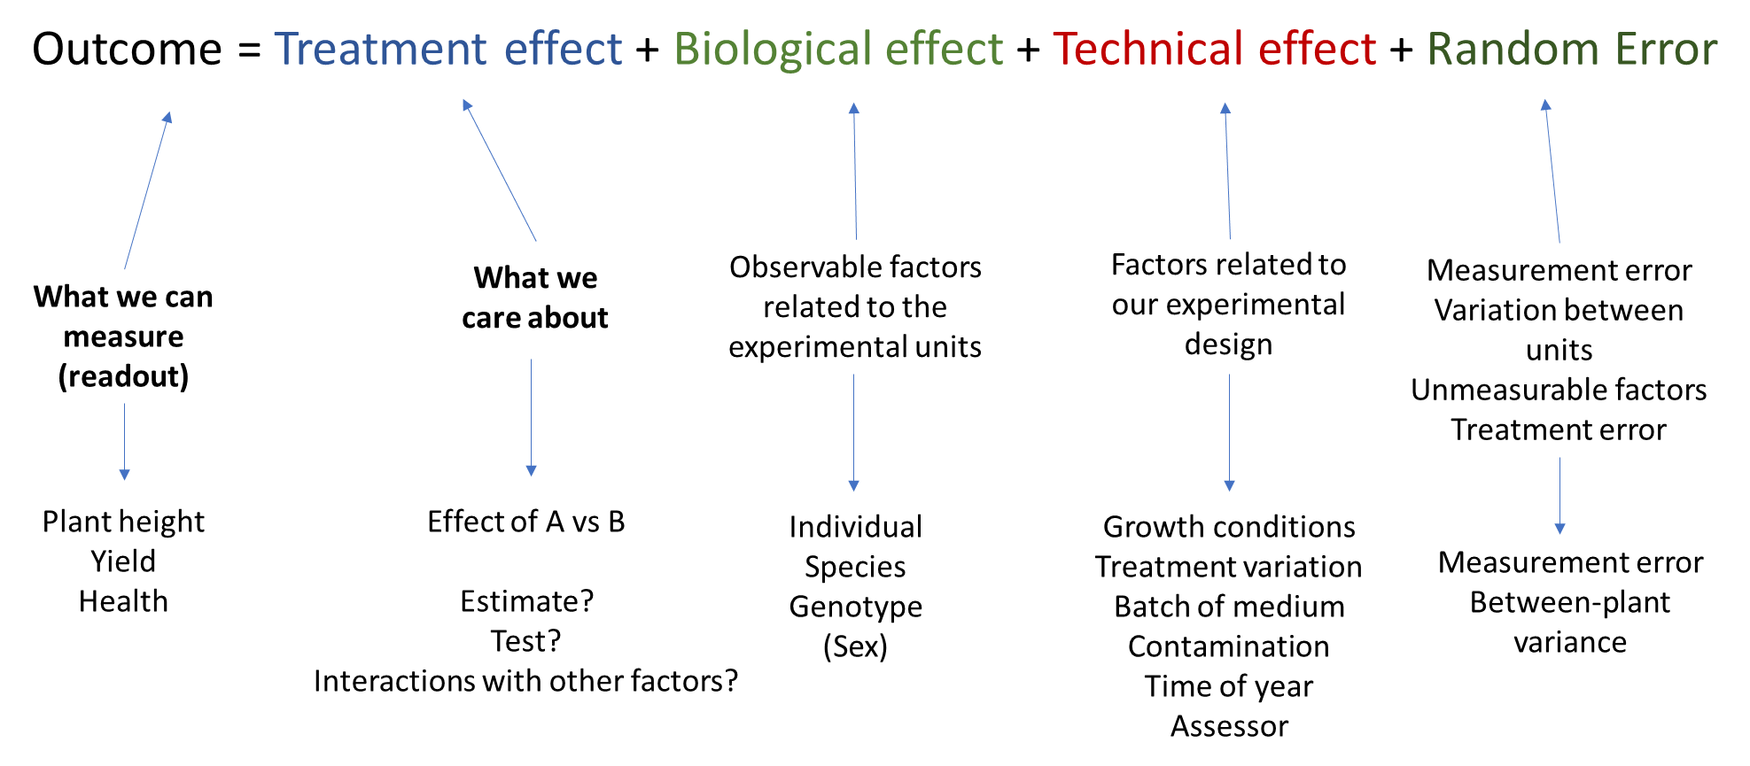

Slide 43
Dealing with effects of nuisance factors
What technical factors should we consider?
What technical factors might affect the outcome measure?
How do we deal with them?
What might happen if we just ignore the technical factor
How do we deal with technical/biological factors we don’t know about or can’t measure?
Eg – suppose we know that temperature is important for plant growth
So “effect of temperature” appears in our design equation. How should we deal with this?
Greenhouse layout
A | A | A | A | B | B | B | B
A | A | A | A | B | B | B | B
Suspected temperature gradient

Slide 44
Dealing with technical and biological factors
Homogeneity
hold temperature constant (may be impractical, lose generalisability. Could work for species or sex)
Matching / Blocking
ensure you have comparisons between units grown at equal temperature
Statistical control
record and control for temperature differences in analysis
Randomisation
assign plants randomly to ensure temps equal on average (works even for unmeasured factors!)

Slide 45
Different designs
Never do this!
Randomisation is essential for validity of experiments
Temperature gradient
Row 1
A | A | A | A | B | B | B | B
A | A | A | A | B | B | B | B
Non-randomised design
Accidentally confounded temperature with treatment
Potential for other unknown factors to interfere
Row 2
Row 1
A | B | A | B | B | A | B | B
A | A | A | A | B | B | B | A
Completely randomised design
Row 2
Valid and unbiased but potentially inefficient
Blocking is a usually a good idea
Randomised complete block design
Row 1
A | B | B | A | B | B | A | B
B | A | B | A | A | A | A | B
Blocking controls for temperature (known factor)
Randomising within blocks removes bias from unknown factors.
We could also insist on balance over rows etc…
Row 2
Block 1
Block 2
Block3
Block4

Slide 46
Real NBI example
A post-doc wants to compare the survival of six different strains of a bacteria on a food preparation surface in typical room temp conditions.
He wants to run three replicates of each strain.
He can run three experiments per day.
Which strains should he run on each day?

Slide 47
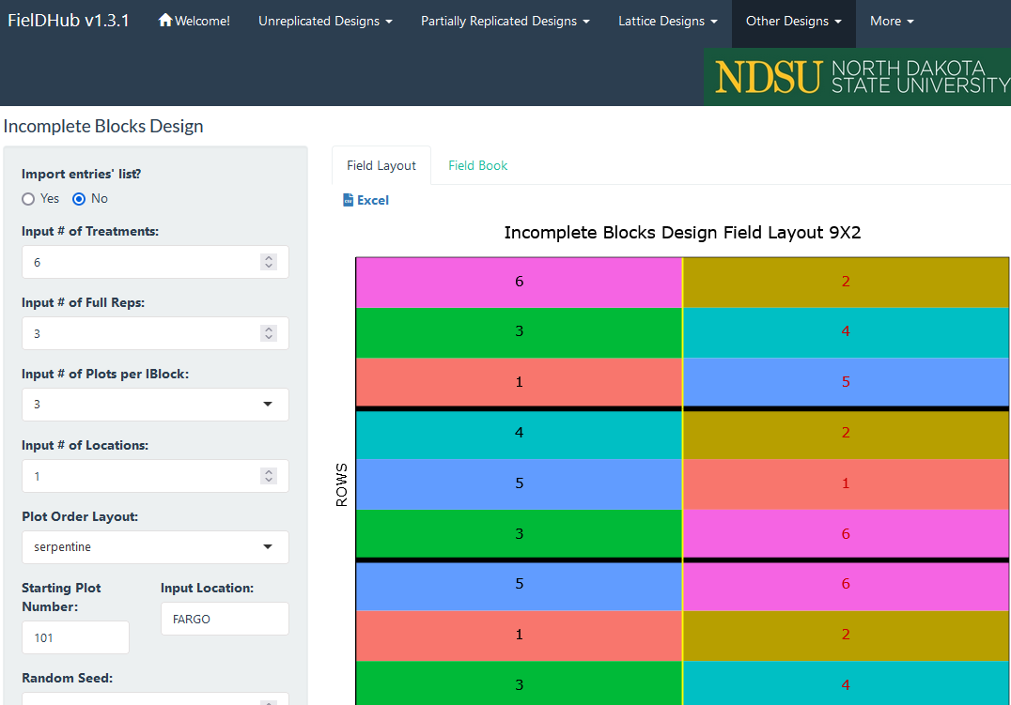
Incomplete blocks design
What might change between days? Temperature, humidity, timings, measurement etc?
Things we can’t predict?
A day is a ‘block’. We can do half a rep in each block:
This is an “incomplete block design”.
https://didiermurillof.github.io/FielDHub/

Slide 48
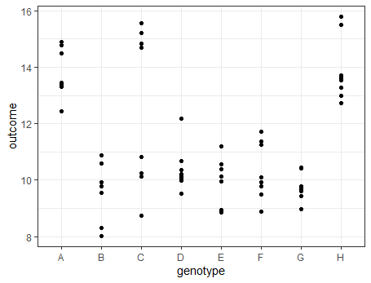
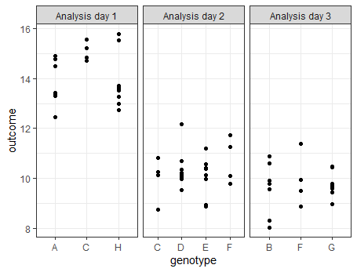
Real(ish) NBI Example
A group analysed the properties of eight genotypes of wheat.
What can we conclude?
Did something happen between days 1 and 2?
We don’t know

Slide 49
Non-randomised studies
If you can randomise, do. This is the basis of the validity of experimental research.
If you can’t randomise, you likely have an observational study.
(survey, cohort study etc)
“Do people with cancer have a different microbiome to people without”
“Can I use metabolomics to diagnose IBD?”
Observational studies are different and rely on random sampling from a population for its validity.
The evidence that comes from observational studies is usually weak.
Not explicitly discussed today but many of the principles discussed here apply.

Slide 50
Example: Sex differences in mice
We know that male and female mice sometimes have different outcomes.
How should we approach this in our animal studies?
Use only males (or only females)
Used to be common practice – but now strongly discouraged
Complete randomisation
Valid but possibly inefficient. Likely housing problems.
Blocked randomisation (separate randomisations for males and females)
Usually the best option. Can remove the sex effect from the design and allows more generalisable results.
In any case include ‘sex’ as a covariate in analysis…
Fin3R webinar on sex-inclusive in vivo research
https://www.helsinki.fi/fi/unitube/video/77f08913-fe6b-452b-8a28-c62e799eb746

Slide 51

Real NBI example 1: Brains and Bias
Scenario
A student was measuring the effect of a genetic mutation on brain lesion frequency in mice
Lesions are counted by hand using image analysis software
First she counted the lesions from brains of in the wild-type mice, next she counted the lesions from brains of the mutant mice
What sources of bias might there be? What should she have done to reduce this?

Slide 52
Brains and bias
Technical factors that might affect the measurement and bias the results?
Order effect
Cognitive bias
Anything else?
Deal with by
Randomisation! (Simple / Blocked)
Blinding
Reduce random error by automation (if possible) or repeated measurement?
Design equation (just for the counting phase..):
lesions = genotype effect + order effect + cognitive bias + mouse effect + measurement error
outcome
‘treatment’ effect
technical factors
random error

Slide 53
Real NBI example. Plate layouts (reducing bias)
Three treatment groups
20 patients per group
Two replicate samples per patient.
For measurement, samples were arranged as opposite on two 96 well plates.
Potential problems here?
Potential solutions?
Other considerations?

Slide 54
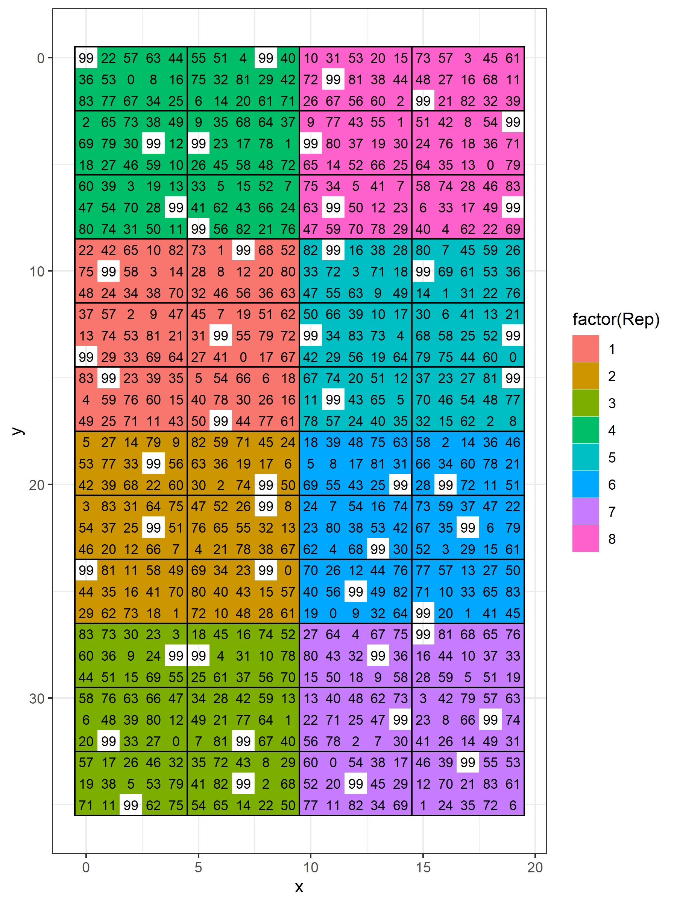
Real NBI example 3. Alpha lattice
More complex situations need more complex designs..
Allocation of crops in a field – with unknown fertility gradients
We want to test 83 different lines of wheat, 8 reps per line. 15 plots per block
How should we plant our field?
Aim – minimise the loss of precision associated with variation across the field
Call in the experts!
Alpha lattice, make sure every pair of lines occurs within a block equally often
Practical knowledge also important, adding a marker so we don’t get lost

Slide 55
Real NBI example 4
Incomplete-block crossover trial

Slide 56
Clustering

Slide 57

‘Clustering’ factors, experimental units
Mixing up one batch of medium A and one batch of medium B, then use these two batches for all the plants
Mixing a new batch of medium for each plant
Which is a better approach?

Slide 58
Batches (clusters) vs blocks
On the face of it, the issue of soil batches is similar to the issue of temperature, in that both are nuisance factors that can affect the outcome
Can you see why they are different from a design point of view?
Stratification / blocking – vary the treatment within levels of the nuisance factor.
Clustering / batches – can only vary the treatment across levels of the nuisance factor (can’t be a blocking factor)
A
B
A
B
B
A
A
B
Location 1
Location 2
Batch 1
Batch 2
4 experimental units
2 experimental units?

Slide 59


Real NBI example 5 – Mice and cages
Experimental unit
The experimental unit is the unit that we can independently treat
Typically we should treat mice (or plants) as independently as possible to get genuine biological replicates
This means fewer mice per cage
Here N = 1 per group
Suppose we want to know the effect of treatment A vs treatment B.
We can only assign treatment at the cage level.
How do you estimate a treatment effect?
If we see a difference between groups, what does this tell us?
Cage A (N=5)
Litter A
Location A
Treatment A
Cage B (N=5)
Litter B
Location B
Treatment B
Mice within cluster can affect each other
Mice within cluster treated together
The cage introduces shared variance between the animals
(The soil batch introduces shared variance between plants.)
We want to avoid this as much as possible

Slide 60
Summary – “Nuisance factors”
Outcome = Treatment effect + Biological effect + Technical effect + Error
We should try to understand which biological and technical nuisance factors that could affect our outcome.
Keeping these factors constant, or blocking for known or measured effects, randomisation for unknown effects help prevent bias and reduce error associated with these factors.
Blinding treatments and assessments is important to prevent cognitive bias
Sometimes clustering is unavoidable, reduce if possible.
Make sure statistical analysis includes known nuisance factors as covariates!

Slide 61
Error and Precision
Natural variation and its relationship with sample size

Slide 62
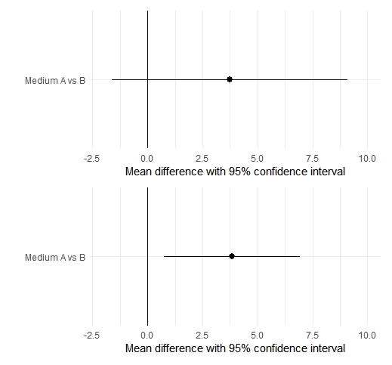
Dealing with error
An imprecise result (bad)
Recall our aim is to get as precise an estimate as possible.
This means small uncertainty.
What causes this uncertainty in estimates?
A more precise result (good)

Slide 63
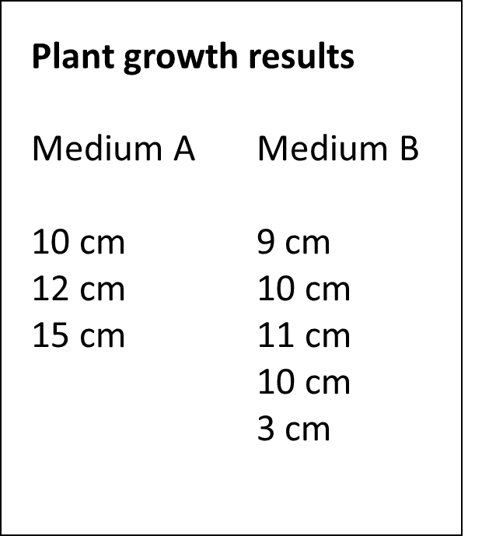
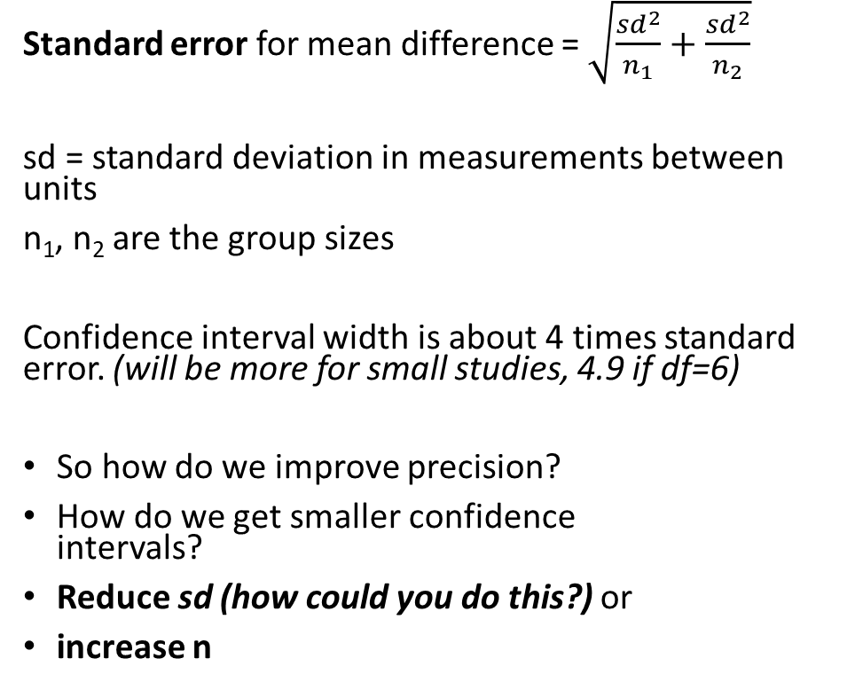

Precision calculations
Standard error for mean difference = $\sqrt{\frac{{sd}^{2}}{n_{1}}+\frac{{sd}^{2}}{n_{2}}}$
sd = standard deviation in measurements between units
n₁, n₂ are the group sizes
Confidence interval width is about 4 times standard error. (will be more for small studies, 4.9 if df=6)
So how do we improve precision?
How do we get smaller confidence intervals?
Reduce sd (how could you do this?) or
increase n
Standard deviation within group
sd = 3cm
$$\sqrt{\frac{3^{2}}{3}+\frac{3^{2}}{5}}=2.2 \text{cm}$$
Standard error
$$2.2×4.8=10.8 \text{cm}$$
Confidence interval width

Slide 64
Sample size calculations
We reduce the influence of random error by replication at different levels.
How many plants should we use?
How many measurements should we take?
If we can easily reduce a large measurement error by taking more measures, then we should
But if measurement is expensive or measurement error is low, then more biological reps might be better.
How many blocks should I use?
How many replicates of the whole experiment?
Related but difficult questions!

Slide 65
How do we choose the sample size?
Precision is linked to sample size
How much variation is there between plants (or mice etc)…
How precise do we need the experiment to be?

Slide 66
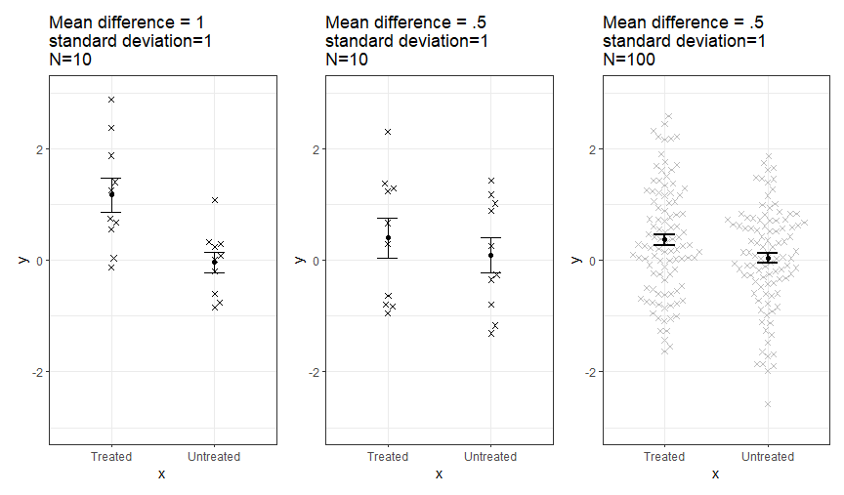
It is easier to see big differences than small differences
The size of the difference needs to be considered in terms of the spread of the data within groups
For any experiment there is a smallest detectable difference.
The ‘standard error’ for each group depends on SD and N
If the true difference is too small compared to the standard errors, it is very unlikely to be detected by the experiment.

Slide 67
So how do we calculate the sample size we need?
Set the required power, calculate N using:
Plausible effect size, minimum size of interest,
Standard deviation of the outcome measure.
For simple two group comparison (two groups of independent mice):
power.t.test( sd = 3 , delta = 3 , power = 80/100 )
Noise in the system (standard deviation)
Signal size we want to detect
How sure do we want to be of detecting it?

Slide 68
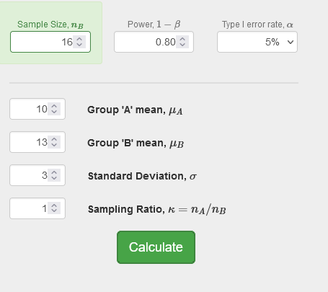
Results (R vs online calculator)
> power.t.test(sd = 3, delta=3, power=80/100)
Two-sample t test power calculation
n = 16.71477
delta = 3
sd = 3
sig.level = 0.05
power = 0.8
alternative = two.sided
NOTE: n is number in *each* group
http://powerandsamplesize.com/Calculators/Compare-2-Means/2-Sample-Equality

Slide 69
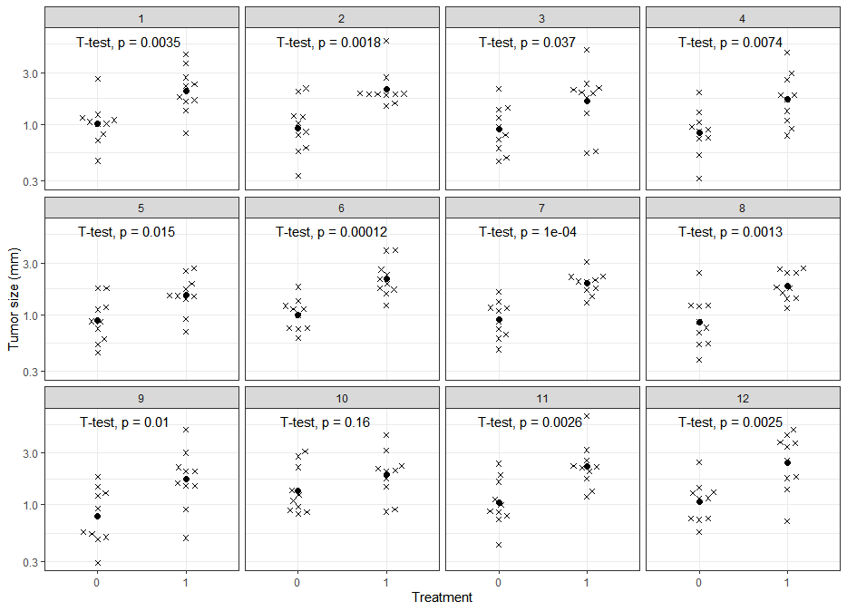
Power by simulation
We can simulate data to see how our tests are likely to turn out.
Here:
true ratio is 2
sd (of log-size) is 0.5
Suggests N=10 is about right
One in 12 studies failed to detect the effect
Look at the p-value instability

Slide 70
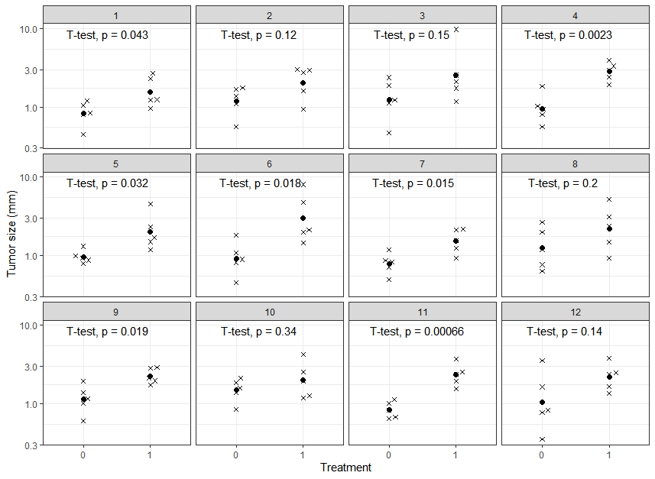
Underpowered
Would N=5 have been enough?
Same parameters as before..
true ratio is 2
sd (of log-size) is 0.5
Now 7/12 studies gave a significant result at p<0.05
Here it would be very risky to use so few mice!
Think about the reliability of the experimental set up and results here.
What if we did experiments, 1, 2 and 3. What would we conclude??

Slide 71
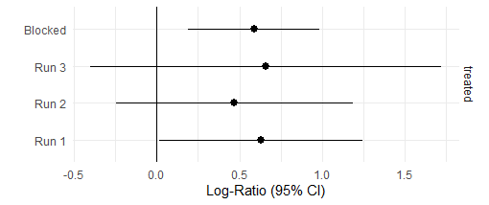
Three replications of an experiment?
Describe the results as estimates instead of tests
Then the inconsistency can be more properly assessed, a single analysis on all the data
Running one big experiment, possibly with blocks, will be a much more efficient use of material
Blocked analysis p-value is 0.0048
How would you interpret these results?
Are they inconsistent?
How would you resolve any inconsistency?
How would you report them?
Does the treatment work?

Slide 72
Sample size calculation
So, to calculate our sample size, we need to know:
How precise the effect estimate needs to be (or minimum interesting difference?)
What is the between-plant variation (standard deviation of plants treated identically)
Then we can use a power calculator or a simulation to see if how reliably we can detect the effect.
There is a slight contradiction here in using a testing paradigm for design but an estimation paradigm for analysis. But this is commonly done right now so we’ll go with it. Sample size based purely on precision is also an option

Slide 73
Where do we get the power calculation inputs?
power.t.test( sd=3, delta=3, power=80/100 )
Standard deviation (precision of the measure)
How do I know what the within-group standard deviation of plant size will be?
Effect size
(size of the signal)
How do I know what effect size to expect from my treatment?
Minimum ‘important’ effect size
Prior studies (although data from pilot studies and prior published studies can seriously mislead)
Theoretical considerations
Prior data in a similar model
Best from your own lab
Extract from old publications
May involve some calculation

Slide 74
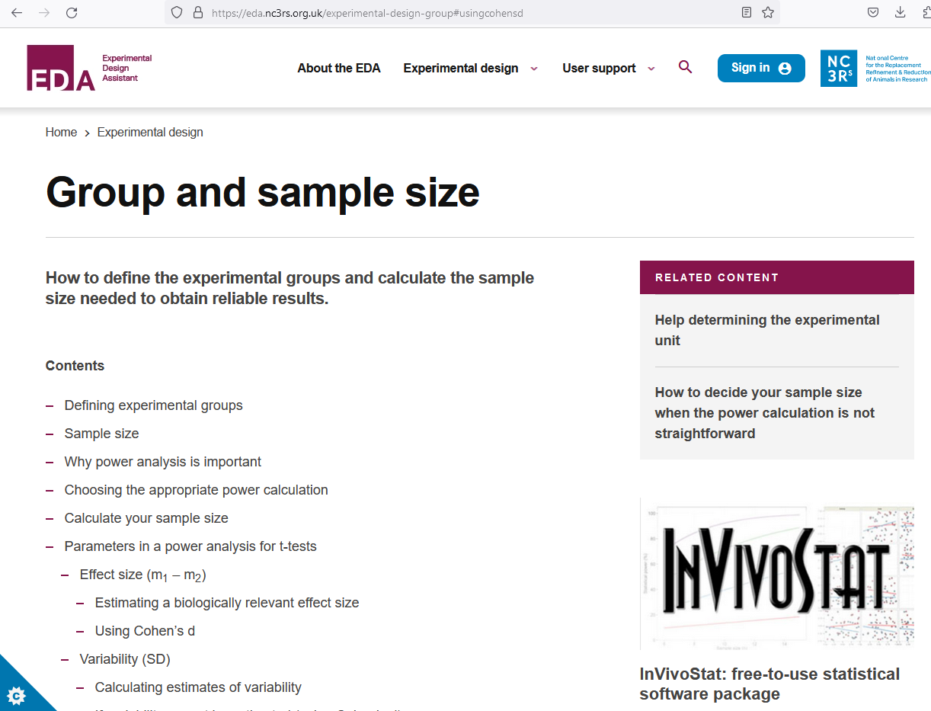
Sample size for other designs
We looked at a simple two group-test but the power calculators extend to other designs/analyses:
Correlation (continuous)
m-way ANOVA (multiple groups, multiple predictors)
Paired analyses / Repeated measures / Clustered analyses
‘Omics (many outcomes/predictors)
Longitudinal studies
In each case the required inputs are similar:
Measure of signal
Measures of noise
Required power
Design / Analysis
N
https://eda.nc3rs.org.uk/experimental-design-group

Slide 75
Increasing sample size at different levels
Remember we have:
Batches (Cages)
Plants within batches (Mice within cages)
Measurements within plants (Measurements within mice)

Slide 76
Sample size at different levels
Increasing the sample size at each level will reduce the impact of the error associated with that level.
If measurement is unreliable, take more measurements per plant (usually easy)
If individual plants are very variable use more plants per soil batch
If there is variability between batches use more soil batches per treatment (usually difficult)
Example:
Blood glucose measurement is very imprecise, so we measure each individual several times
Example:
If we believe there are strong ‘cage effects’ we need more cages of animals

Slide 77
Summary (design)
Get the question right
Estimate something!
Consider what data you need to answer that question well enough
Consider the technical and biological factors that might bias the results
Randomise and blind where possible
Consider sources of variation and how to remove them
Consider sample size

Slide 78
Break
We’ll do data analysis and dilemmas after a short break.

Slide 79
Analysis of Data from Experiments

Slide 80
Aim of the session
Demonstrate key ideas with a simple analysis of our ‘plant growth’ experiment
Linear modelling as our main tool
Graphing and reporting
Diagnostics
Code is available!
Different studies will need different details, some more complex!

Slide 81
Analysis
How should we analyse data?
Statistical model follows fundamental design equation.
Estimated with regression analysis / linear models
Estimates of effects, hypothesis tests etc come from this
ANOVA / t-tests form part of this approach..
But modern software allows more unified analyses
Analysis should follow design
Software like R makes this approach very natural
Make sure our models fit our data and our design

Slide 82
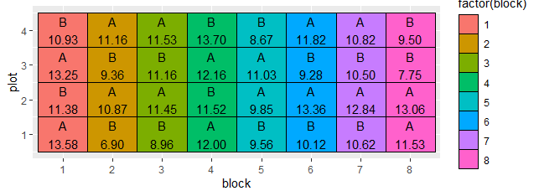
Design and data
Suspected temperature gradient
Simple plant experiment
Two treatments
Eight blocks across greenhouse
Four plants randomised per block
Outcome: Plant height
Question: why did I randomly allocate within the blocks?
Plant ID | treatment | block | height
1 | A | 1 | 13.57889
2 | B | 1 | 10.92815
3 | A | 2 | 11.16231
4 | B | 2 | 6.896838
5 | A | 3 | 11.45195
6 | B | 3 | 11.15601
… | … | … | …
27 | A | 6 | 13.35773
28 | B | 6 | 9.28416
29 | A | 7 | 12.84345
30 | B | 7 | 10.62137
31 | A | 8 | 11.52944
32 | B | 8 | 7.74956

Slide 83
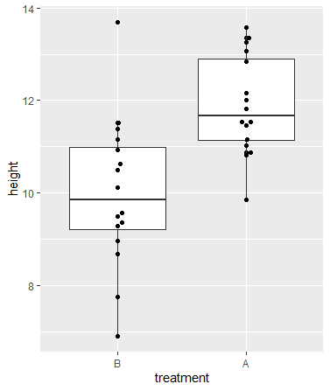
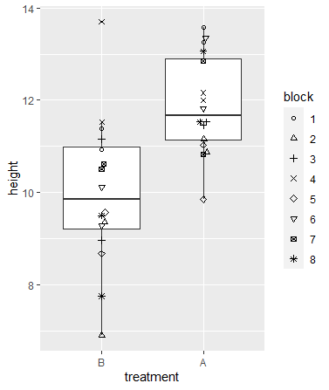
Descriptive analysis
These graphs are fine but do not capture the design!
Can be misleading?
Better? May be useful to see if there's strong evidence of clustering

Slide 84
Analysis follows design equation
Design equation:
Plant height = Treatment effect + Greenhouse location + Error
Regression model formula in R (random effect of block):
Height ~ Treatment + (1|Block)
Simple random ‘error’ is assumed so not written explicitly

Slide 85
R code and results
model3 = lmer(data=dat , height ~ treatment + (1|block))
summary(model3)
Fixed effects:
Estimate Std. Error df t value Pr(>|t|)
(Intercept) 9.9937 0.4109 11.2652 24.323 4.31e-11 ***
treatmentA 1.9003 0.3865 23.0000 4.917 5.74e-05 ***
---
Signif. codes: 0 ‘***’ 0.001 ‘**’ 0.01 ‘*’ 0.05 ‘.’ 0.1 ‘ ’ 1

Slide 86
Getting a useful estimate
A (probably) more useful output..
gtsummary::tbl_regression(model3)
Characteristic | Beta | 95% CI¹ | p-value
Treatment
B | — | —
A | 1.9 | 1.1, 2.7 | <0.001
¹ CI = Confidence Interval

Slide 87
ANOVA table
If you want an analysis of variance table..
anova(model3)
Type III Analysis of Variance Table with Satterthwaite's method
Sum Sq Mean Sq NumDF DenDF F value Pr(>F)
treatment 28.888 28.888 1 23 24.173 5.737e-05 ***
---
Signif. codes: 0 ‘***’ 0.001 ‘**’ 0.01 ‘*’ 0.05 ‘.’ 0.1 ‘ ’ 1

Slide 88
Checking the model validity
Assumptions made in the estimation?
Plant height ‘errors’ are
Identically distributed
Independent of each other
Normally distributed
Are these assumptions OK?
We should check by plotting the data and using diagnostic plots

Slide 89
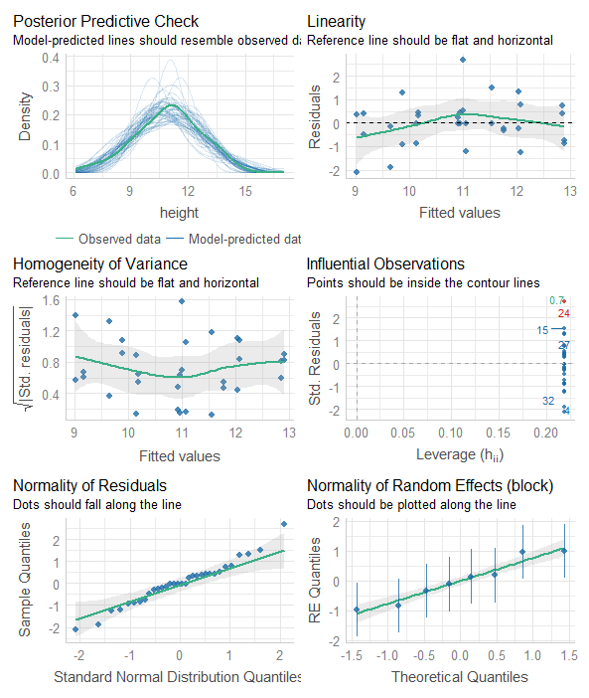
Diagnostic plots
performance::check_model(model3)
Checks of:
Modelled data looks like real data
Normality of plants variances
Normality of block variances
Effect of outliers
Equal variance across predictor levels
All looks fine!

Slide 90
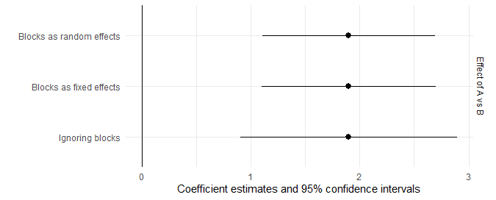
What if we ignored the design?
We could just have run a t-test between the treated and untreated
How would the answer differ?
More precision if we analyse properly!
(We can also get biased results by ignoring design, so don’t!)
“Analyse as you randomise” – DESIGN MATTERS!
 | Ignoring blocks | Blocks as fixed effects | Blocks as random effects
Effect of A vs B | 1.9 | 1.9 | 1.9
95% Confidence interval | 0.91 to 2.9 | 1.10 to 2.70 | 1.11 to 2.69

Slide 91
Analysing ‘clustered’ data

Slide 92
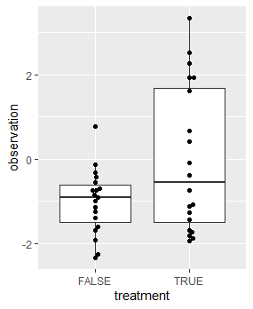
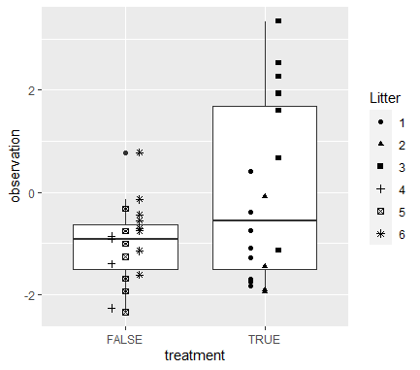
Example: Ignore clustering at your peril!
(Simulation closely following some real QIB data)
p-value = 0.02836
p-value = 0.438
Significant effect?
No evidence for an effect

Slide 93
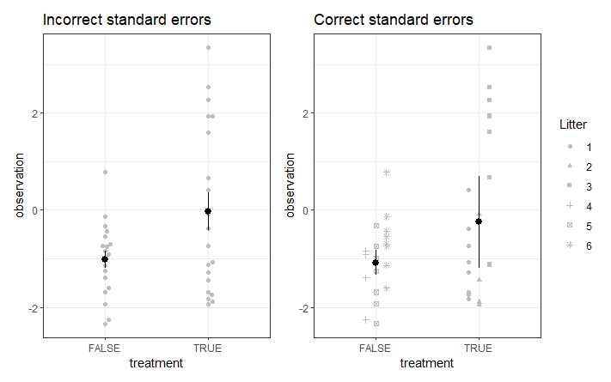
Correct standard errors
Standard errors should be calculated from the clusters as biological reps (treating the mice as technical reps).
The clustered experiment could be much less precise than you might think
You must calculate the standard errors and p-values correctly, otherwise there’s a big risk of false positives

Slide 94
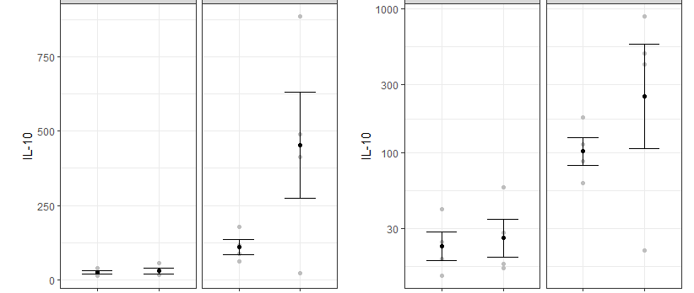
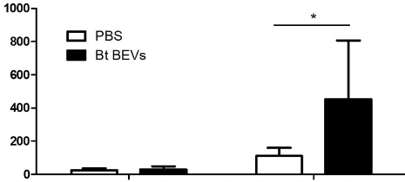
What if we ignored the assumptions (real NBI example 7)
One-way ANOVA with post-hoc test
But clearly not equal variances across groups
Significant difference?
Log-transformation helps
No significant difference

Slide 95
Summary (analysis)
Have a pre-specified analysis plan (pre-registration)
Understand the analysis you are doing! (read, get help if you don’t)
Focus on estimation rather than or as well as testing
Linear modelling as a first line approach
Make sure your analysis model follows your design
Check your model / test assumptions for every analysis
Don’t ‘p-hack’ or cherry pick outcomes
Workflow:
Descriptive analysis / plotting
Cleaning and coding
Fit model
Check model validity
Get model outputs
Visualise / interpret model outputs

Slide 96
More robust science

Slide 97
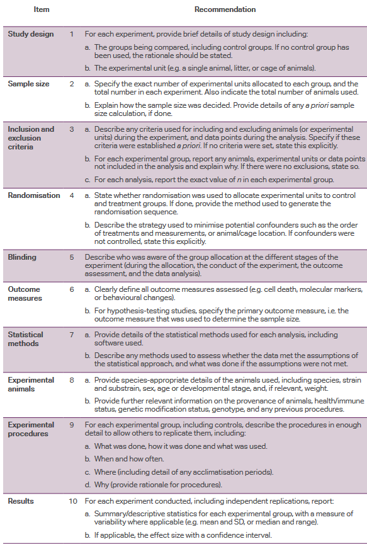
Design and reporting checklists
CONSORT statement and checklist for clinical trials ensures that the key elements of design are reported.
STROBE for epidemiology studies
ARRIVE guidance now exists for animal work..
Reporting guides for many different types of studies exist
Review these in your design phase, make sure you have every element covered.
Often when reading biology papers it is very hard to work out what the experimental design was!
ARRIVE essential ten
https://arriveguidelines.org/

Slide 98
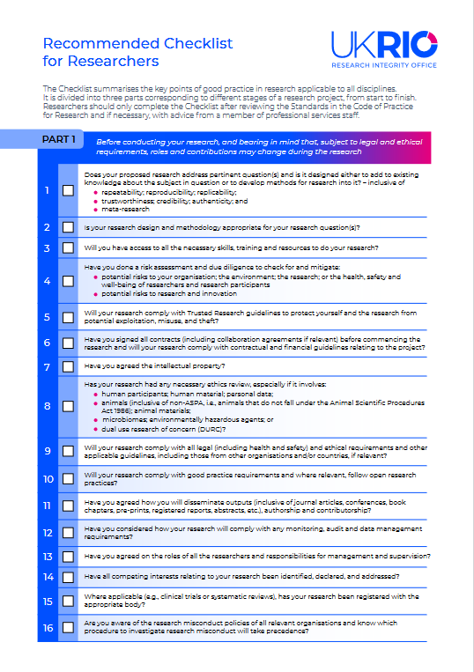
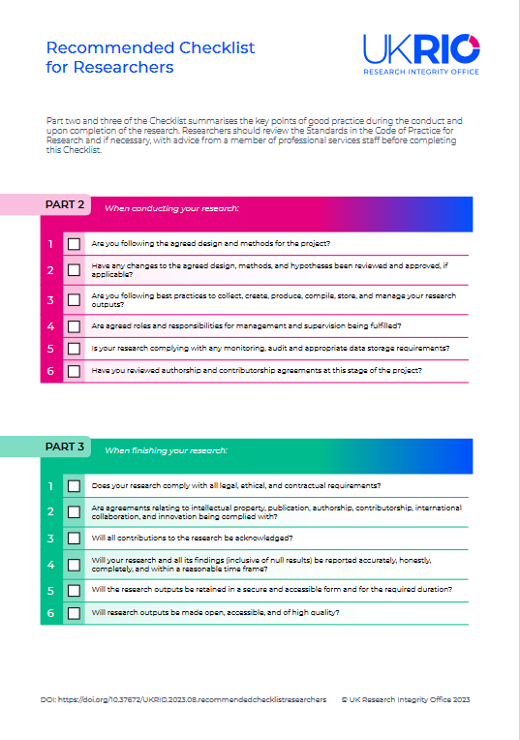
Anticipate potential issues with UKRIO checklist
https://ukrio.org/wp-content/uploads/UKRIO-Recommended-Checklist-for-Researchers.pdf
Planning
Conduct
Dissemination

Slide 99
Summary
Good experimental design and analysis is important to:
Answer the right question
Prevent bias and being ‘wrong’.
Improve precision and efficiency
Take the time to learn and understand the issues relevant to your field.
Use checklists to improve your design, analysis and reporting
Use the support available from:
Training courses
Books
Online sources
Local technical experts

Slide 100
Dilemmas

Slide 101
Dilemmas
Real design and analysis questions from NBI projects over the past few years
Decide on one you’d like to discuss
Spend X minutes talking about it with the group
We’ll discuss the most ‘popular’ choices in the class
Written discussion available for all of the problems after the workshop

